Slide 1
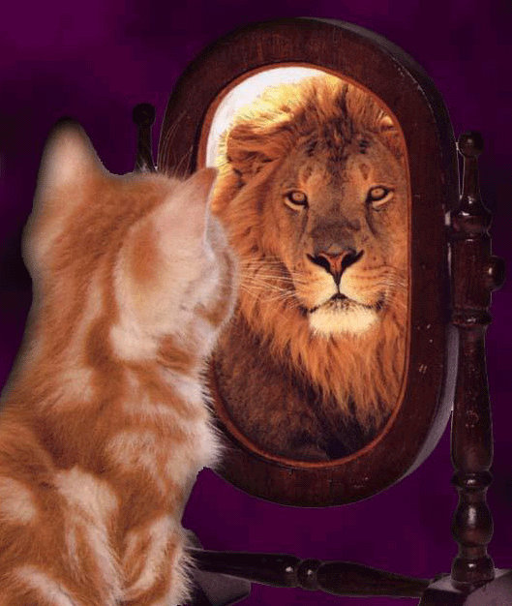
Character Analysis in Short Stories
Flat vs. round characters
Static vs. dynamic characters

Slide 2
Character
A person, animal, or thing in a work of literature.
Characterization
The process that an author uses to tell readers about characters.
Authors use words to create a mental image of a character in a story.

Slide 3
Types of Characterization
Direct Characterization
The author literally tells what the character is like.
Example: The boy was stubborn and bad-mannered.
Indirect Characterization
Author hints at what the character is like using details that show character thoughts, actions, speech, etc.
Ex: The little boy bit his sister when she refused to share her toys.

Slide 4
Character
Protagonist: the main character of the story. The plot usually revolves around this character.
Antagonist: the person who opposes the protagonist

Slide 5
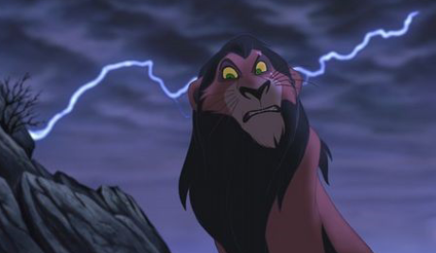
Flat Character
Not fully developed
Only know 1 side of character
Lacks a realistic personality; often a stereotype (air head, tough guy, class clown, etc).
Helps move the plot along (the audience already “gets” flat characters)
Minor characters are usually flat characters
Example from “The Gold Cadillac”?
Evil villain, Scar
"ditzy" or "airhead“ girl
See example from TV

Slide 6
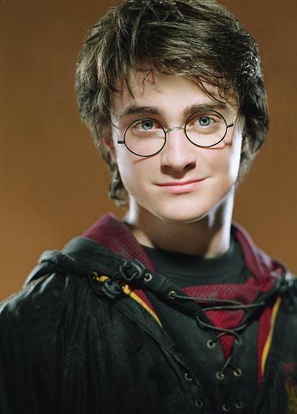
Round Character
Fully-developed
Has many traits (bad and good) shown in the story
Readers feel that they know the character so well that he or she has become a real person.
Protagonists and antagonists are usually round characters.

Slide 7
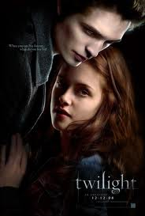
More Types of Characters
Dynamic Character
Experiences a basic change in character through the events of the story
The change is internal and may be sudden, but the events of the plot should make it seem unavoidable
The protagonist is almost always dynamic.
Examples from The Twilight series or The Lightening Thief series?
Static Character
Does not experience a basic character
change during the course of the story
Supporting characters are often static.
Examples from The Twilight series or
The Lightening Thief series?

Slide 8
How do we analyze character in stories?
1) Identify character traits using ASTAR
-Appearance -Actions -Thoughts
-Speaks -Reactions of others
2) Is the character static or dynamic?
3) Is the character flat or round?
4) What is the conflict involving the character?
5) What language is used by the character or by the author to describe the character?

